Slide 1
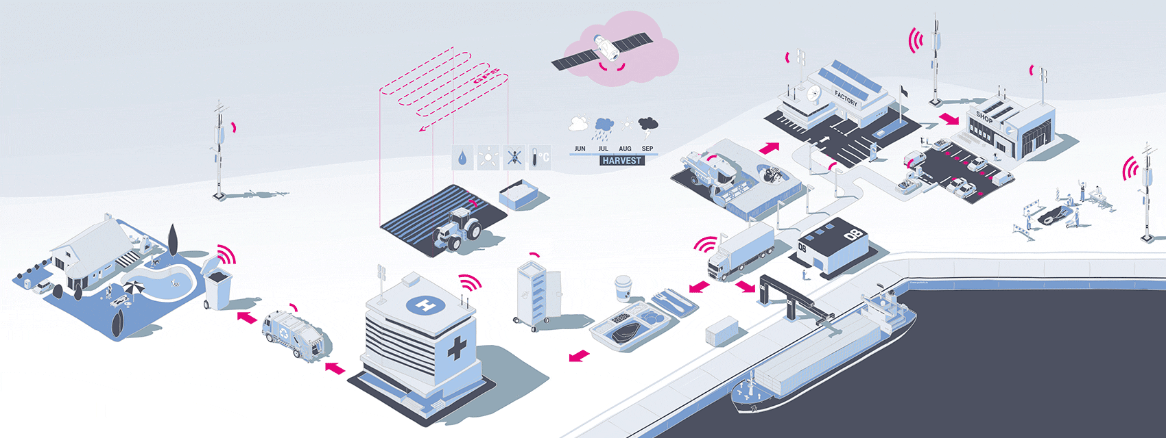
Introduction to IoT
Prof. C.P. Gupta
Department of Computer Sc. and Engineering,
Rajasthan Technical University, Kota
Book website: http://www.internet-of-things-book.com
Bahga & Madisetti, © 2015

Slide 2
Outline
2
Definition of IoT
Characteristics of IoT
Physical design of IoT
Logical design of IoT
IoT protocols
IoT levels and deployment templates
Book website: http://www.internet-of-things-book.com
Bahga & Madisetti, © 2015

Slide 3
What is IoT?
The Internet of Things (IoT) is the network of physical objects or "things" embedded with electronics, software, sensors, and network connectivity, which enables these objects to collect and exchange data.
IoT allows objects to be sensed and controlled remotely across existing network infrastructure, creating opportunities for more direct integration between the physical world and computer-based systems, and resulting in improved efficiency, accuracy and economic benefit.

Slide 4
History of IoT
The concept of the Internet of Things first became popular in 1999, through the Auto-ID Center at MIT and related market-analysis publications. R
Radio-frequency identification (RFID) was seen as a prerequisite for the IoT at that point. If all objects and people in daily life were equipped with identifiers, computers could manage and inventory them. Besides using RFID, the tagging of things may be achieved through such technologies as near field communication, barcodes, QR codes, bluetooth, and digital watermarking.

Slide 5
How IoT Works?
Internet of Things is not the result of a single novel technology; instead, several complementary technical developments provide capabilities that taken together help to bridge the gap between the virtual and physical world. These capabilities include:
Communication and cooperation
Addressability
Identification
Sensing
Actuation
Embedded information processing
Localization
User interfaces

Slide 6
How IoT Works?
RFID
Sensor
Smart Tech
Nano Tech
To identify and track the data of things
To collect and process the data to detect the changes in the physical status of things
To enhance the power of the network by devolving processing capabilities to different part of the network.
To make the smaller and smaller things have the ability to connect and interact.

Slide 7
The Structure of IoT
The IoT can be viewed as a gigantic network consisting of networks of devices and computers connected through a series of intermediate technologies where numerous technologies like RFIDs, wireless connections may act as enablers of this connectivity.
Tagging Things : Real-time item traceability and addressability by RFIDs.
Feeling Things : Sensors act as primary devices to collect data from the environment.
Shrinking Things : Miniaturization and Nanotechnology has provoked the ability of smaller things to interact and connect within the “things” or “smart devices.”
Thinking Things : Embedded intelligence in devices through sensors has formed the network connection to the Internet. It can make the “things” realizing the intelligent control.

Slide 8
Current Status & Future Prospect of IoT
“Change is the only thing permanent in this world”

Slide 9
IoT as a Network of Networks:
These networks connected with added security, analytics, and management capabilities. This will allow IoT to become even more powerful in what it can help people achieve.

Slide 10
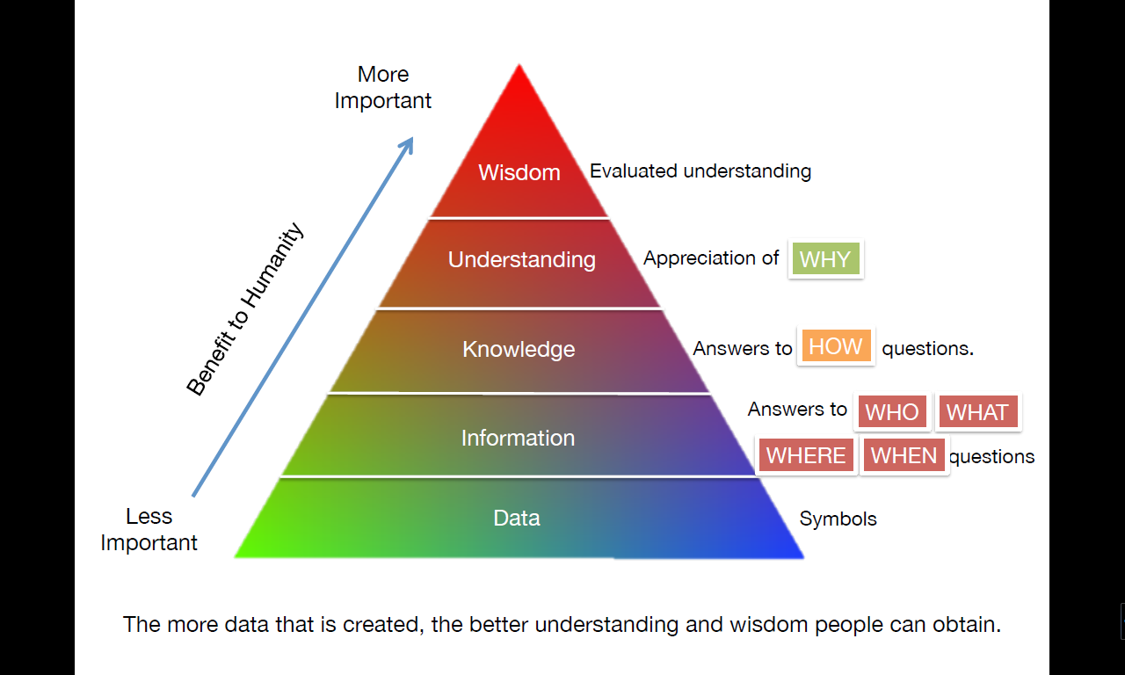
Knowledge Management – Turning Data into Wisdom
The more data that is created, the better understanding and wisdom people can obtain.

Slide 11
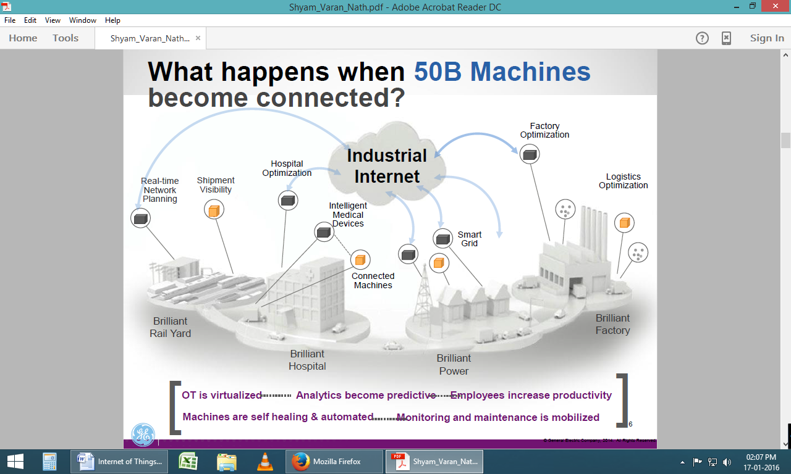
The Future of IoT
"The Sky's not the limit. It's only the beginning with IoT."

Slide 12
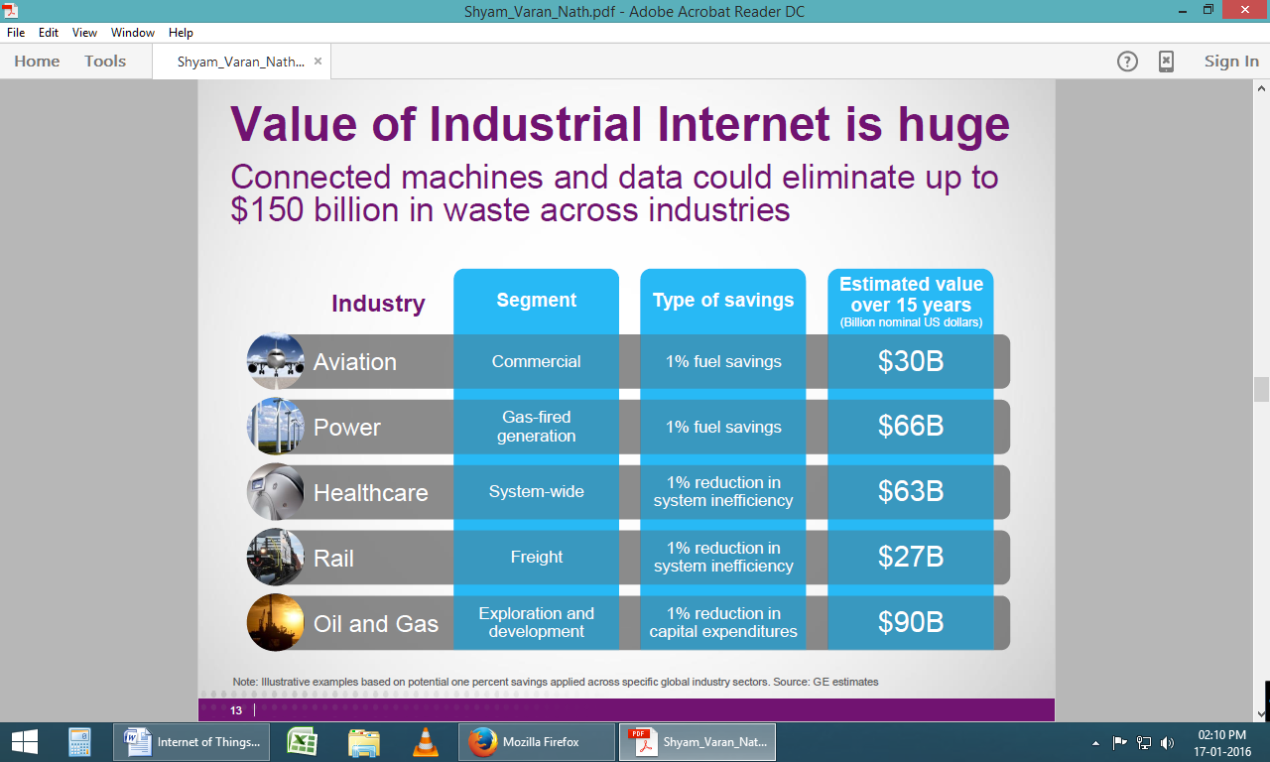
The Potential of IoT
GE’s estimates on potential of just ONE percent savings applied using IoT across global industry sectors.

Slide 13
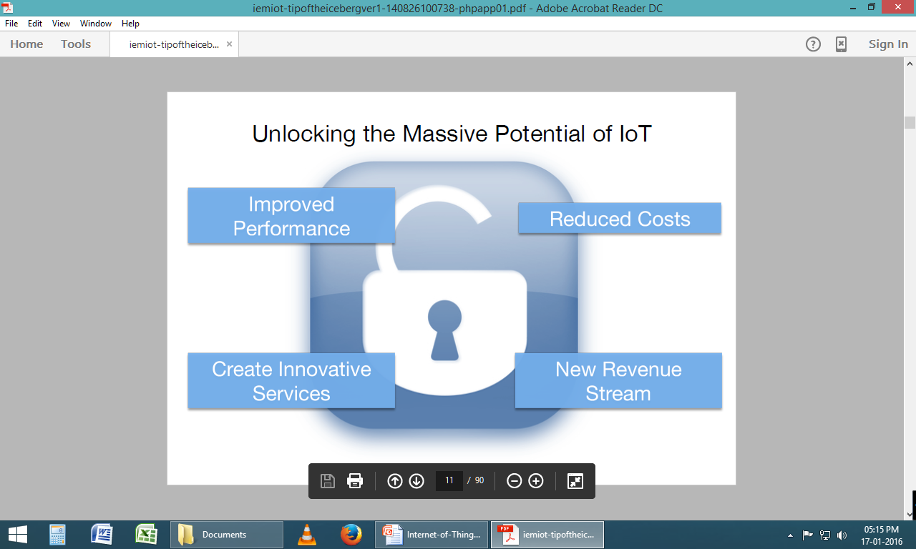
Unlock the Massive potential of IoT

Slide 14
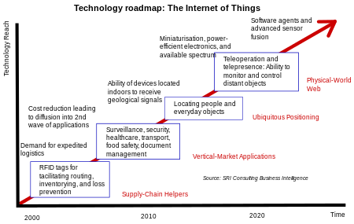
Technology roadmap of IoT

Slide 15

What is IoT
Internet of Things (IoT) comprises things that have unique identities and are connected to the Internet
Network of Physical Objects
The focus on IoT is in the configuration, control and networking via the Internet of devices or “Things” that are traditionally not associated with the internet
Eg: pump, utility meter, car engine
IoT is a new revolution in the capabilities of the endpoints that are connected to the internet

Slide 16
What is IoT
Network of Physical Objects
The Scope of IoT is not limited to just connecting things (device, appliances, machines) to the Internet
IoT allows these things to communicate and exchange data (control& information)
Processing on these data will provide us various applications towards a common user or machine goal

Slide 17
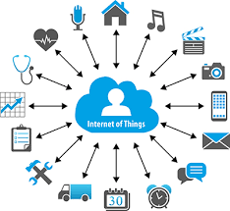
IoT

Slide 18

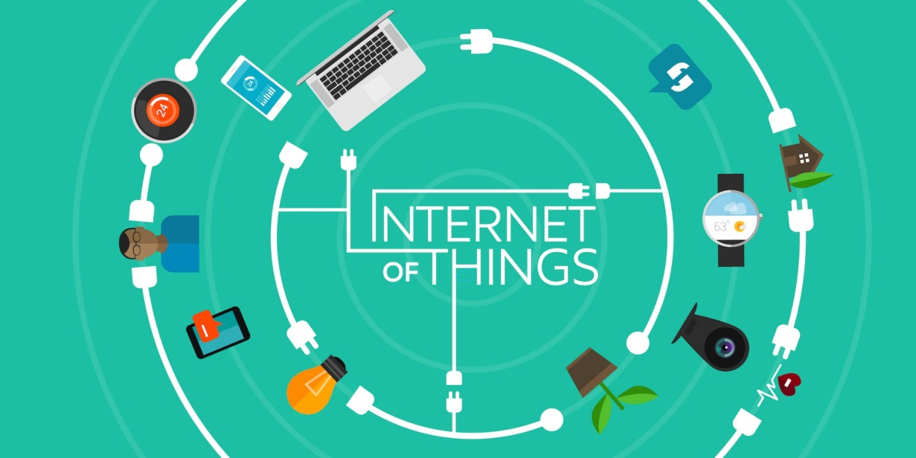
Idea: Move from Internet of People → Internet of Things
Internet appears everywhere in the world
It is primarily connection between people
Internet of Things is a plan to connect things also using the same medium

Slide 19
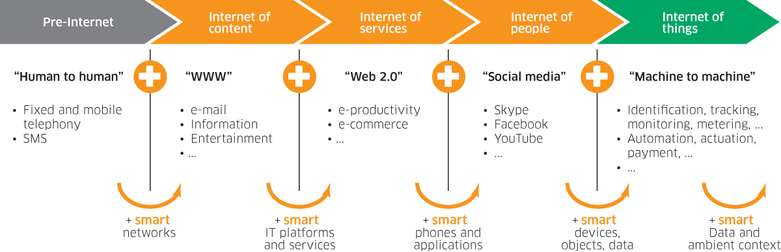
Internet of Things - Evolution

Slide 20




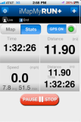
IOT: People connecting with Things
ECG sensor
Internet
Motion sensor
Motion sensor
Motion sensor

Slide 21
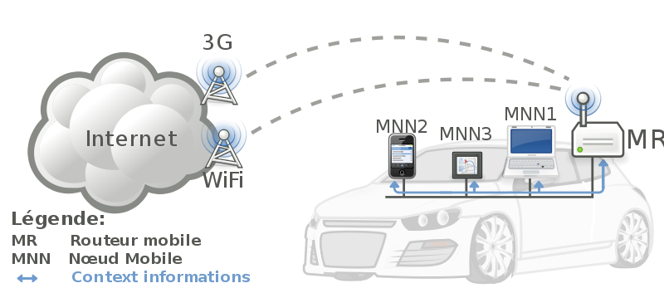


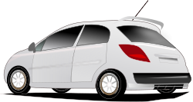
IoT: Things connecting with Things
- Complex and heterogeneous
resources and networks

Slide 22
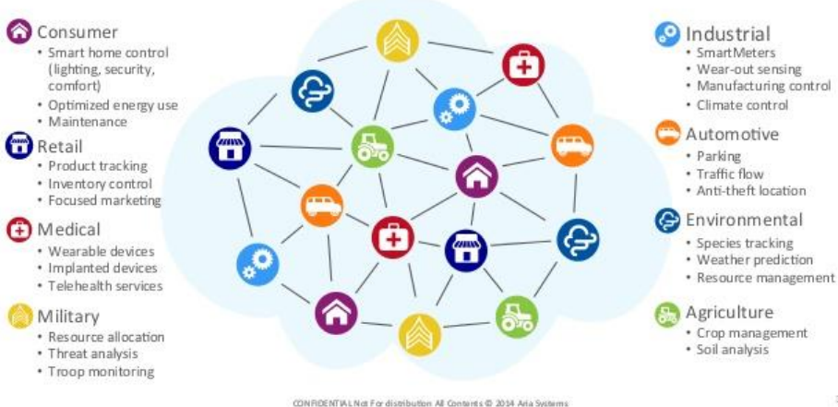
Looming Opportunity

Slide 23
Applications of IoT

Slide 24
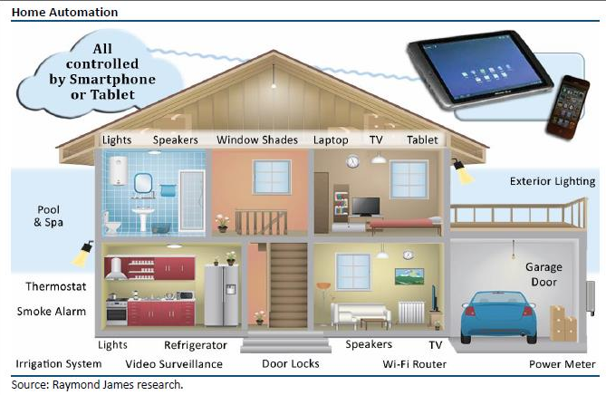
IoT Applications : Intelligent Home

Slide 25
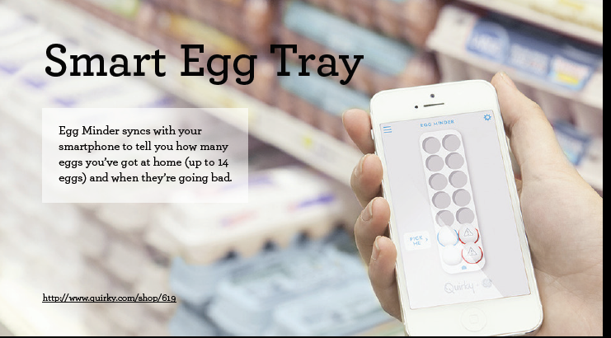

Slide 26
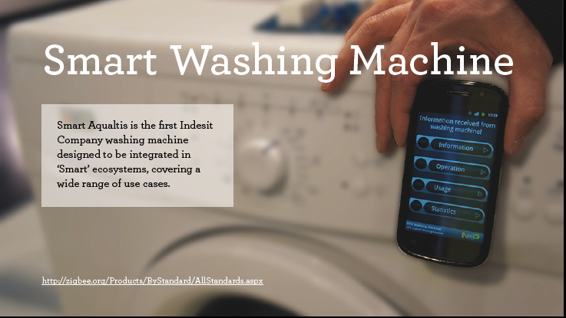

Slide 27
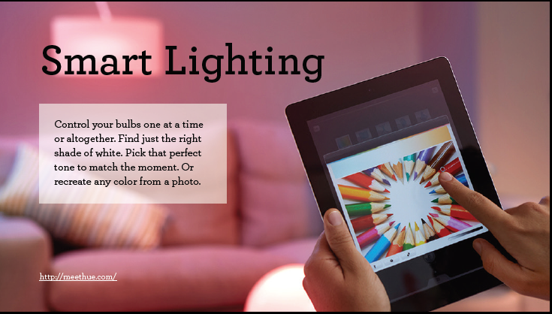

Slide 28
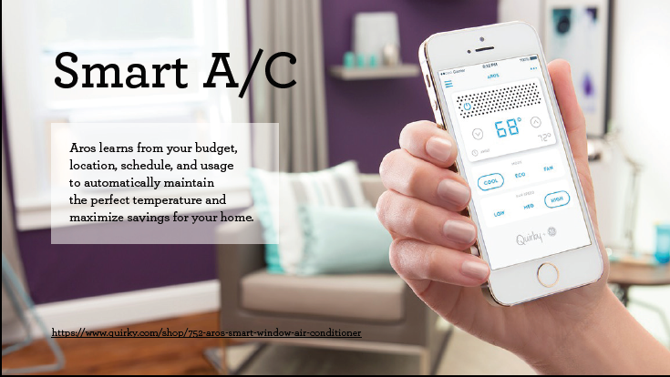

Slide 29
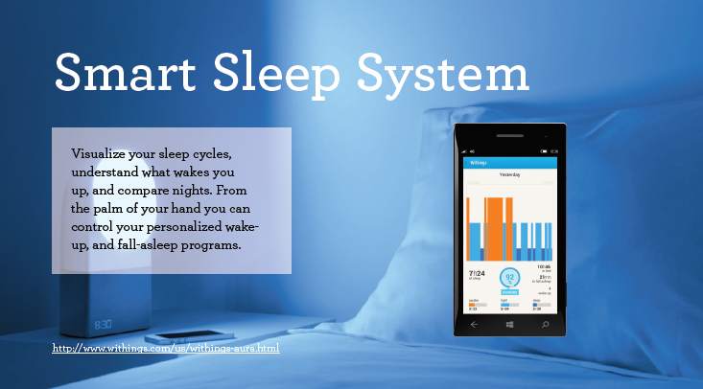

Slide 30
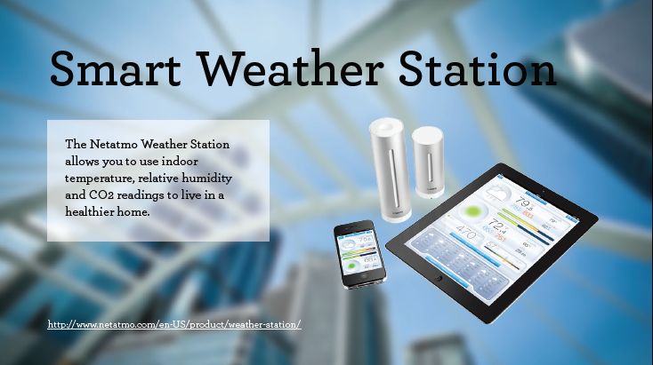

Slide 31
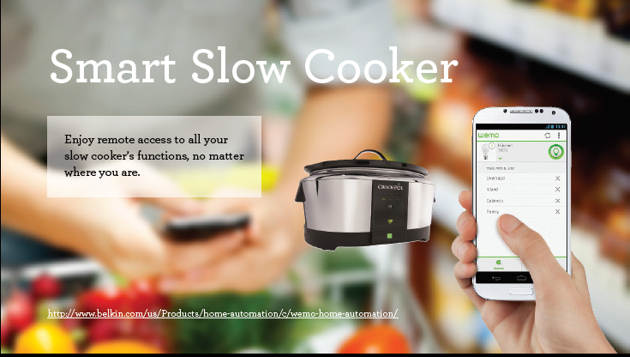

Slide 32
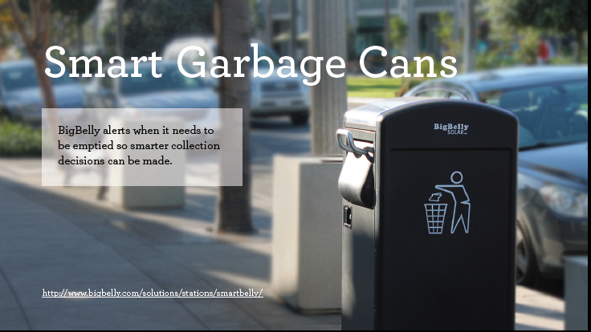

Slide 33


Slide 34
IoT
Internet Of Things is Fully Networked and Connected Devices sending analytics data back to cloud or data center.
The definition of Internet of things is that it is the network in which every object or thing is provided unique identifier and data is transferred through a network without any verbal communication.
Scope of IoT is not just limited to just connecting things to the internet, but it allows these things to communicate and exchange data, process them as well as control them while executing applications.

Slide 35
Formal Definition of IoT
A dynamic global network infrastructure with self- configuring capabilities based on standard and interoperable communication protocols, where physical and virtual “things” have identities, physical attributes, and use intelligent interfaces, and are seamlessly integrated into information network that communicate data with users and environments.

Slide 36
Characteristics of IoT
Dynamic Global network & Self-Adapting : Adapt the changes w.r.t changing contexts
Self Configuring : Eg. Fetching latest s/w updates without manual intervention.
Interoperable Communication Protocols : Communicate through various protocols
Unique Identity : Such as Unique IP Address or a URI
Integrated into Information Network : This allows to communicate and exchange data with other devices to perform certain analysis.

Slide 37
Physical Design of IoT
Things in IoT
IoT Protocols

Slide 38
Things in IoT
Refers to IoT devices which have unique identities that can perform sensing, actuating and monitoring capabilities.
IoT devices can exchange data with other connected devices or collect data from other devices and process the data either locally or send the data to centralized servers or cloud – based application back-ends for processing the data.

Slide 39
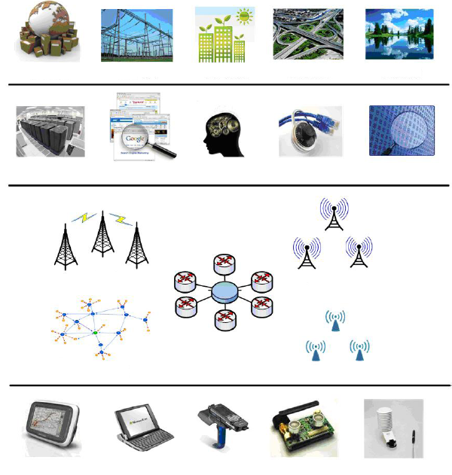
IoT Architecture
Integrated Application
Smart Grid
Green Building
Smart Transport
Env. Monitor
Information Processing
Data Center
Search Engine
Smart Decision
Info. Security
Data Mining
WWAN
WMAN
Network Construction
Internet
WPAN
WLAN
Sensing & Identification
GPS
Smart Device
RFID
Sensor
Sensor

Slide 40
TECHNOLOGICAL CHALLENGES OF IoT
At present IoT is faced with many challenges, such as:
Scalability
Technological Standardization
Inter operability
Discovery
Software complexity
Data volumes and interpretation
Power Supply
Interaction and short range communication
Wireless communication
Fault tolerance

Slide 41
Criticisms and Controversies of IoT
Scholars and social observers and pessimists have doubts about the promises of the ubiquitous computing revolution, in the areas as:
Privacy
Security
Autonomy and Control
Social control
Political manipulation
Design
Environmental impact
Influences human moral decision making

Slide 42
IoT Technologies

Slide 43
IoT Technologies
Hardware (Device)
Communication Technology
Protocols for IoT
Software (IDE)
Cloud Platforms

Slide 44
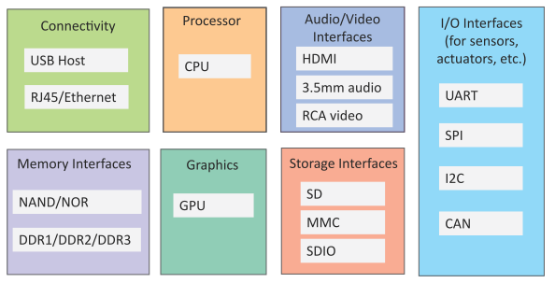
Generic Block Diagram of an IoT Device
An IoT device may consist of several interfaces for connections to other devices, both wired and wireless.
I/O interfaces for sensors
Interfaces for internet connectivity
Memory and storage interfaces
Audio/video interfaces

Slide 45
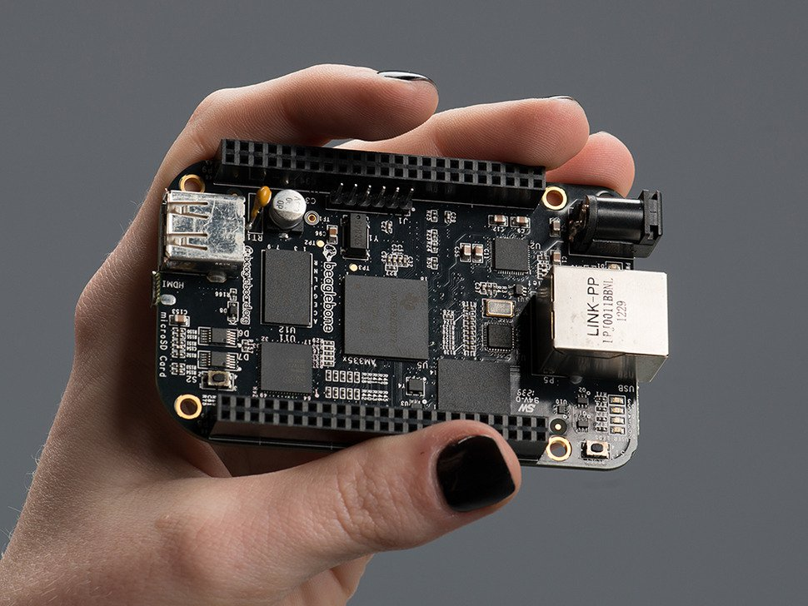
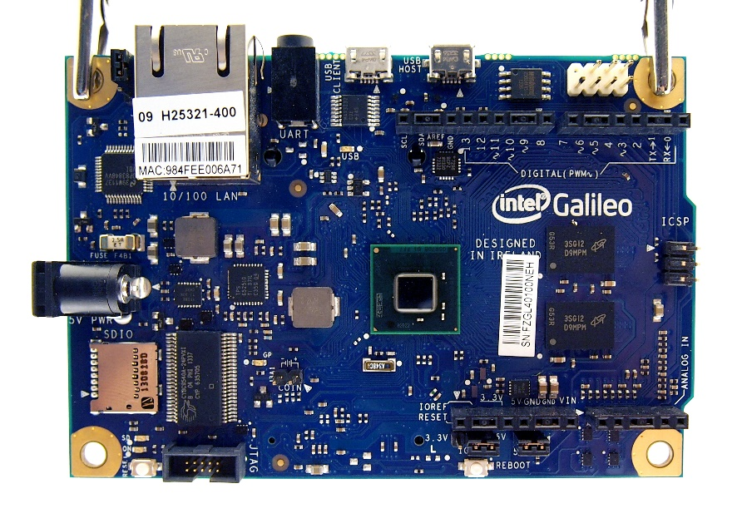
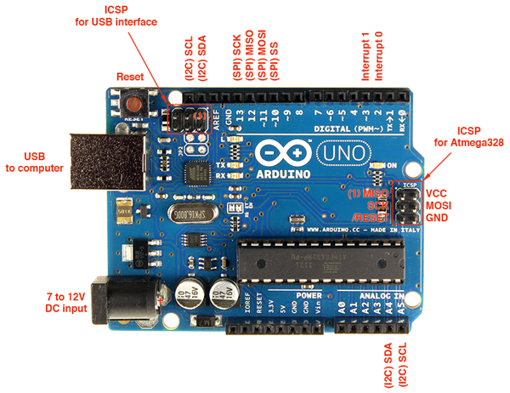
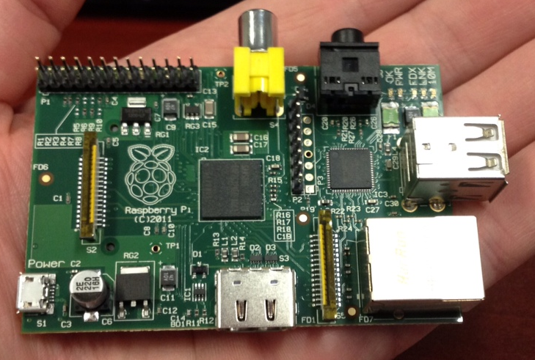
Implementing Smart Objects
Beaglebone black
Intel Galileo
Raspberry Pi
Arduino Uno

Slide 46
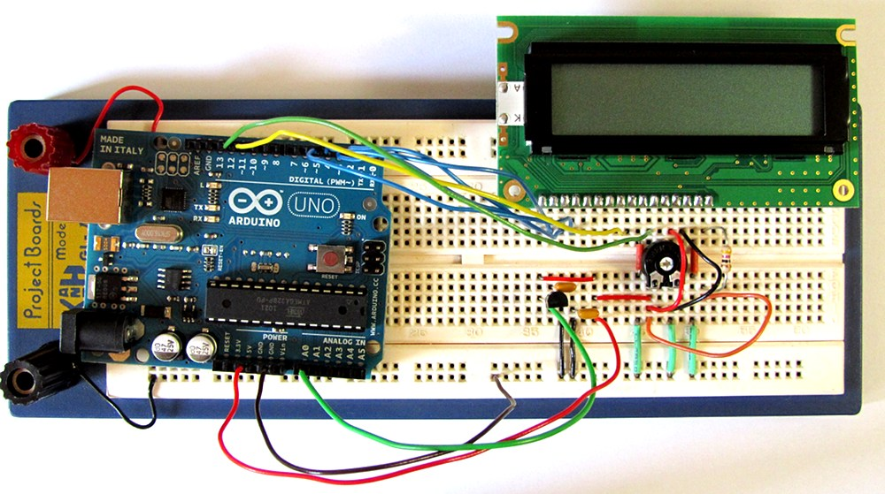
Board Connection

Slide 47
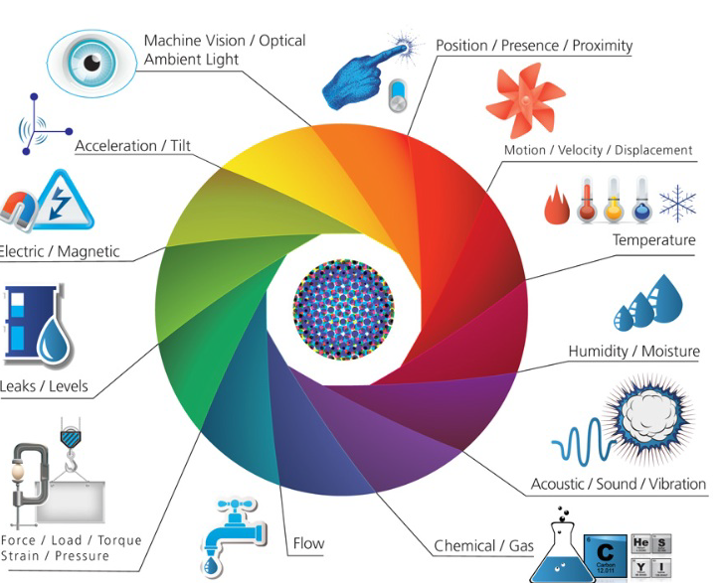
Sensors and Actuators

Slide 48
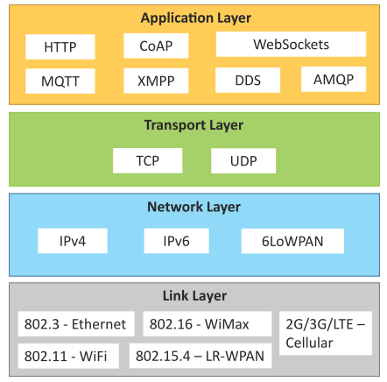
IoT Protocols
Link Layer
802.3 – Ethernet
802.11 – WiFi
802.16 – WiMax
802.15.4 – LR-WPAN
2G/3G/4G
Network/Internet Layer
IPv4
IPv6
6LoWPAN
Transport Layer
TCP
UDP
Application Layer
HTTP
CoAP
WebSocket
MQTT
XMPP
DDS
AMQP

Slide 49
IoT Protocols…Link Layer…Ethernet
Sr.No | Standard | Shared medium
1 | 802.3 | Coaxial Cable…10BASE5
2 | 802.3.i | Copper Twisted pair …..10BASE-T
3 | 802.3.j | Fiber Optic……10BASE-F
4 | 802.3.ae | Fiber…..10Gbits/s
Data Rates are provided from 10Gbit/s to 40Gb/s and higher

Slide 50
IoT Protocols…Link Layer…WiFi
Collection of Wireless LAN
Data Rates from 1Mb/s to 6.75 Gb/s
Sr.No | Standard | Operates in
1 | 802.11a | 5 GHz band
2 | 802.11b and 802.11g | 2.4GHz band
3 | 802.11.n | 2.4/5 GHz bands
4 | 802.11.ac | 5GHz band
5 | 802.11.ad | 60Hz band

Slide 51
IoT Protocols…Link Layer…WiMax
Sr.No | Standard | Data Rate
1 | 802.16m | 100Mb/s for mobile stations 1Gb/s for fixed stations
Collection of Wireless Broadband standards
Data Rates from 1.5Mb/s to 1 Gb/s

Slide 52
IoT Protocols…Link Layer…LR-WPAN
Collection of standards for low-rate wireless personal area networks
Basis for high level communication protocols such as Zigbee
Data Rates from 40Kb/s to 250Kb/s
Provide low-cost and low-speed communication for power constrained devices

Slide 53
Generic Block Diagram of an IoT Device
An IoT device may consist of several interfaces for connections to other devices, both wired and wireless.
I/O interfaces for sensors
Interfaces for internet connectivity
Memory and storage interfaces
Audio/video interfaces

Slide 54
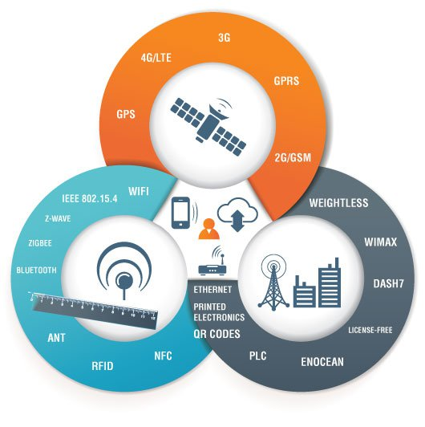
IoT Technologies : Communication Technology

Slide 55
IoT Technologies : Protocols
CoAP ( Constrained Application Protocol)
MQTT (Message Queue Telemetry Transport)
XMPP (Extensible Messaging and Presence Protocol)
6LoWPAN (Low power Wireless Personal Area Networks)

Slide 56
IoT Protocols…Link Layer…LR-WPAN
Collection of standards for low-rate wireless personal area networks
Basis for high level communication protocols such as Zigbee
Data Rates from 40Kb/s to 250Kb/s
Provide low-cost and low-speed communication for power constrained devices

Slide 57
IoT Protocols…Link Layer…2G/3G/4G –Mobile Communication
Sr.No | Standard | Operates in
1 | 2G | GSM-CDMA
2 | 3G | UMTS and CDMA 2000
3 | 4G | LTE
Data Rates from 9.6Kb/s (for 2G) to up to 100Mb/s (for 4G)

Slide 58
IoT Protocols…Network/Internet Layer
Responsible for sending of IP datagrams from source to destination network
Performs the host addressing and packet routing
Host identification is done using hierarchical IP addressing schemes such as IPV4 or IPV6

Slide 59
IoT Protocols…Network Layer
IPV4
IPV6
6LoWPAN (IPV6 over Low power Wireless Personal Area Network)
Used for devices with limited processing capacity
Operates in 2.4 GHz
Data Rates of 250Kb/s

Slide 60
IoT Protocols…Transport Layer
Provides end-to-end message transfer capability independent of the underlying network
It provides functions such as error control, segmentation, flow-control and congestion control

Slide 61
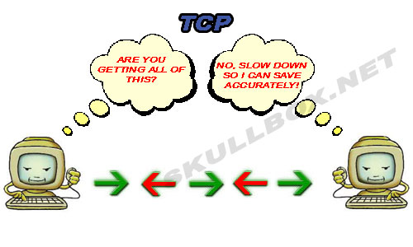
IoT Protocols…TCP
Transmission Control Protocol
Connection Oriented
Ensures Reliable transmission
Provides Error Detection Capability to ensure no duplicity of packets and retransmit lost packets
Flow Control capability to ensure the sending data rate is not too high for the receiver process
Congestion control capability helps in avoiding congestion which leads to degradation of n/w performance

Slide 62
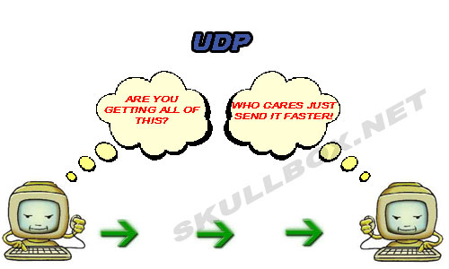
IoT Protocols…UDP
User Datagram Protocol
Connectionless
Does not ensures Reliable transmission
Does not do connection before transmitting
Does not provide proper ordering of messages
Transaction oriented and stateless

Slide 63

IoT Protocols…Application Layer…Hyper Transfer Protocol
Forms foundation of World Wide Web(WWW)
Includes commands such as GET,PUT, POST, HEAD, OPTIONS, TRACE..etc
Follows a request-response model
Uses Universal Resource Identifiers(URIs) to identify HTTP resources

Slide 64
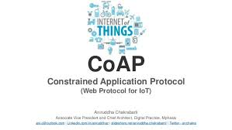
IoT Protocols…Application Layer…CoAP
Constrained Application Protocol
Used for Machine to machine (M2M) applications meant for constrained devices and n/w’s
Web transfer protocol for IoT and uses request-response model
Uses client –server architecture
Supports methods such as GET,POST, PUT and DELETE

Slide 65
IoT Protocols…Application Layer…WebSocket
Allows full-duplex communication over single socket
Based on TCP
Client can be a browser, IoT device or mobile application

Slide 66
IoT Protocols…Application Layer…MQTT
Message Queue Telemetry Transport , light-weight messaging protocol
Based on publish-subscribe model
Well suited for constrained environments where devices have limited processing, low memory and n/w bandwith requirement

Slide 67
IoT Protocols…Application Layer…XMPP
eXtensible Messaging and Presence Protocol
For Real time communication and streaming XML data between n/w entities
Used for Applications such as Multi-party chat and voice/video calls.
Decentralized protocol and uses client server architecture.

Slide 68
IoT Protocols…Application Layer…DDS
Data Distribution Service is a data-centric middleware standard for device-to-device or machine-to-machine communication.
Publish subscribe model where publishers create topics to which subscribers can use.
Provides Quality-of-service control and configurable reliability.

Slide 69
IoT Protocols…Application Layer…AMQP
Advanced Messaging Queuing Protocol used for business messaging.
Supports both point-to-point and publisher/subscriber models, routing and queuing
Broker here receives messages from publishers and route them over connections to consumers through messaging queues.

Slide 70
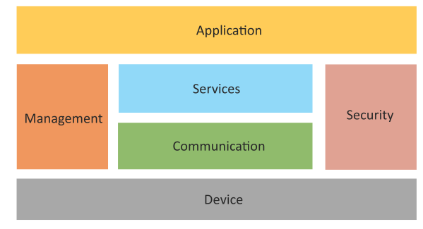
Logical Design of IoT
Logical design of an IoT system refers to an abstract representation of the entities and processes without going into the low-level specifics of the implementation.
An IoT system comprises a number of functional blocks that provide the system the capabilities for identification, sensing, actuation, communication and management.

Slide 71
Logical Design of IoT
Device: Devices such as sensing, actuation, monitoring and control functions.
Communication: IoT Protocols
Services like device monitoring, device control services, data publishing services and device discovery
Management: Functions to govern the system
Security: Functions as authentication, authorization, message and content integrity, and data security
Applications

Slide 72
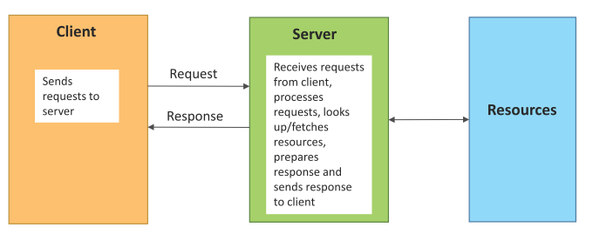
Request–Response Communication Model
Request–Response is a communication model in which the client sends requests to the server and the server responds to the requests.
When the server receives a request, it decides how to respond, fetches the data, retrieves resource representations, prepares the response and then sends the response to the client.
Stateless communication model

Slide 73
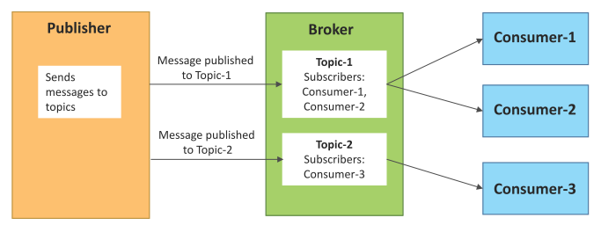
Publish–Subscribe Communication Model
Publish–Subscribe is a communication model that involves publishers, brokers and consumers.
Publishers are the source of data. Publishers send the data to the topics which are managed by the broker. Publishers are not aware of the consumers.
Consumers subscribe to the topics which are managed by the broker.
When the broker receives data for a topic from the publisher, it sends the data to all the subscribed consumers.

Slide 74
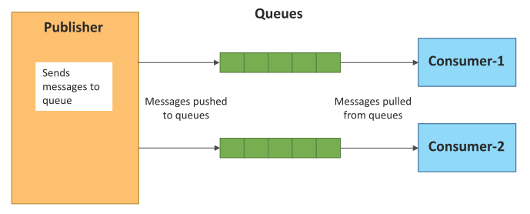
Push–Pull Communication Model
Push–Pull is a communication model in which the data producers push the data to queues and the consumers pull the data from the queues. Producers do not need to be aware of the consumers.
Queues help in decoupling the messaging between the producers and consumers.
Queues also act as a buffer which helps in situations when there is a mismatch between the rate at which the producers push data and the rate at which the consumers pull data.

Slide 75
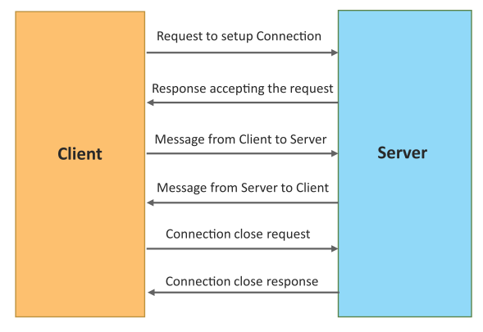
Exclusive Pair Communication Model
Exclusive Pair is a bidirectional, fully duplex communication model that uses a persistent connection between the client and the server.
Once the connection is set up it, remains open until the client sends a request to close the connection.
Client and server can send messages to each other after connection setup.

Slide 76
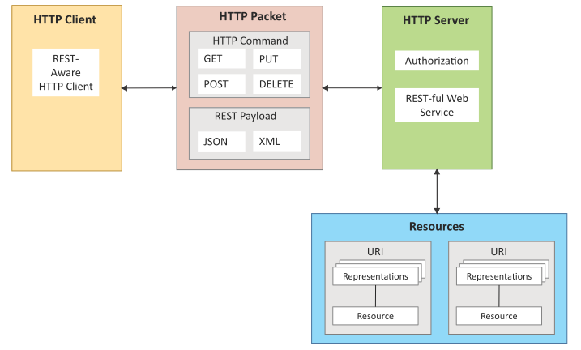
REST-based Communication APIs
Representational State Transfer (REST) is a set of architectural principles by which you can design web services and web APIs that focus on a system’s resources and how resource states are addressed and transferred.
REST APIs follow the request–response communication model.
REST architectural constraints apply to the components, connectors and data elements within a distributed hypermedia system.

Slide 77
REST-based Communication APIs Constraints
Client – Server
Stateless
Cacheable
Layered System
Uniform Interface
Code on demand
Client
Server
Request
Response
Request
Response

Slide 78
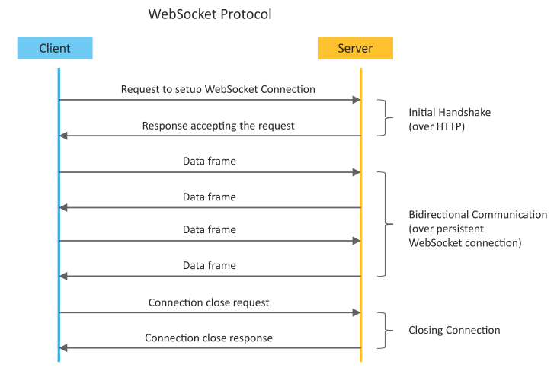
WebSocket-based Communication APIs
WebSocket APIs allow bi-directional, full duplex communication between clients and servers.
WebSocket APIs follow the exclusive pair communication model.

Slide 79
Differences between REST and WebSocket-based Communication APIs
Comparison Based on | REST | Websocket
State | Stateless | Stateful
Directional | Unidirectional | Bidirectional
Req-Res/Full Duplex | Follow Request Response Model | Exclusive Pair Model
TCP Connections | Each HTTP request involves setting up a new TCP Connection | Involves a single TCP Connection for all requests
Header Overhead | Each request carries HTTP Headers, hence not suitable for real-time | Does not involve overhead of headers.
Scalability | Both horizontal and vertical are easier | Only Vertical is easier

Slide 80
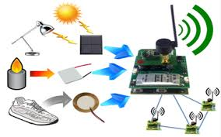

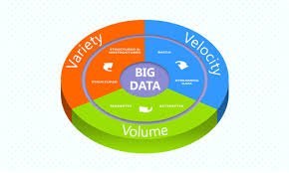
IoT Enabling Technologies
Wireless Sensor Network
Cloud Computing
Big Data Analytics
Embedded Systems

Slide 81
WSN
Distributed Devices with sensors used to monitor the environmental and physical conditions
Consists of several end-nodes acting as routers or coordinators too
Coordinators collects data from all nodes / acts as gateway that connects WSN to internet
Routers route the data packets from end nodes to coordinators.

Slide 82
Example of WSNs in IoT & Protocols used
Example
Weather monitoring system
Indoor Air quality monitoring system
Soil moisture monitoring system
Survelliance systems
Health monitoring systems
Protocols
Zigbee

Slide 83
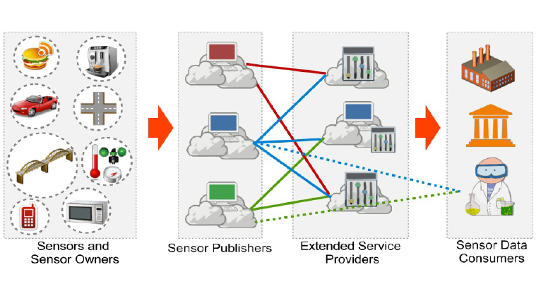
IoT Technologies : Cloud (Sensing as-a-service Model)

Slide 84
Cloud Computing
Deliver applications and services over internet
Provides computing, networking and storage resources on demand
Cloud computing performs services such as Iaas, Paas and Saas
Iaas : Rent Infrastructure
Paas : supply an on-demand environment for developing, testing, delivering and managing software applications.
Saas : method for delivering software applications over the Internet, on demand and typically on a subscription basis.

Slide 85

Big Data Analytics
Collection of data whose volume, velocity or variety is too large and difficult to store, manage, process and analyze the data using traditional databases.
It involves data cleansing, processing and visualization
Lots of data is being collected and warehoused
Web data, e-commerce
purchases at department/ grocery stores
Bank/Credit Card transactions
Social Network

Slide 86
Big Data Analytics
Variety Includes different types of data
Structured
Unstructured
SemiStructured
All of above

Slide 87
Big Data Analytics
Velocity Refers to speed at which data is processed
Batch
Real-time
STreams

Slide 88
Big Data Analytics
Volume refers to the amount of data
Terabyte
Records
Transactions
Files
Tables

Slide 89
IoT Levels and Deployment Templates
An IoT system comprises the following components:
Device: An IoT device allows identiﬁcation, remote sensing, actuating and remote monitoring capabilities.
Resource: Resources are software components on the IoT device for accessing, processing and storing sensor information, or for controlling actuators connected to the device. Resources also include the software components that enable network access for the device.
Controller Service: Controller service is a native service that runs on the device and interacts with the web services. Controller service sends data from the device to the web service and receives commands from the application (via web services) for controlling the device.
Book website: http://www.internet-of-things-book.com
Bahga & Madisetti, © 2015

Slide 90
IoT Levels and Deployment Templates
Database: Database can be either local or in the cloud and stores the data generated by the IoT device.
Web Service: Web services serve as a link between the IoT device, application, database and analysis components. Web service can be implemented using HTTP and REST principles (REST service) or using the WebSocket protocol (WebSocket service).
Analysis Component: This is responsible for analyzing the IoT data and generating results in a form that is easy for the user to understand.
Application: IoT applications provide an interface that the users can use to control and monitor various aspects of the IoT system. Applications also allow users to view the system status and the processed data.
Book website: http://www.internet-of-things-book.com
Bahga & Madisetti, © 2015

Slide 91
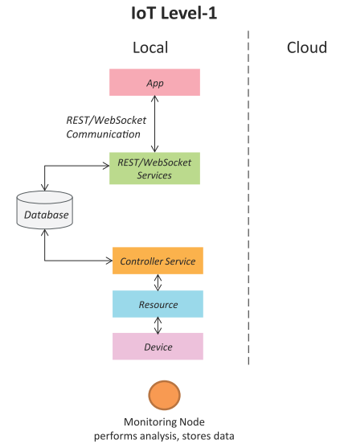
IoT Level-1
A level-1 IoT system has a single node/device that performs sensing and/or actuation, stores data, performs analysis and hosts the application.
Level-1 IoT systems are suitable for modelling low-cost and low-complexity solutions where the data involved is not big and the analysis requirements are not computationally intensive.
Book website: http://www.internet-of-things-book.com
Bahga & Madisetti, © 2015

Slide 92
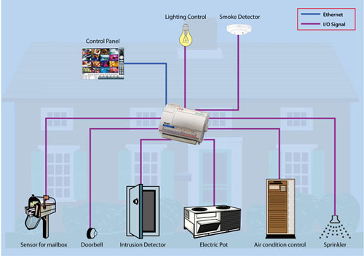
IoT – Level 1 Example …Home Automation System

Slide 93
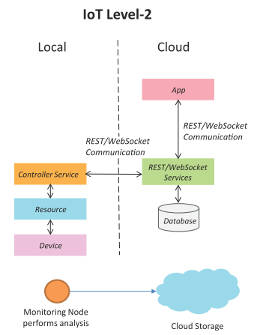
IoT Level-2
A level-2 IoT system has a single node that performs sensing and/or actuation and local analysis.
Data is stored in the cloud and the application is usually cloud-based.
Level-2 IoT systems are suitable for solutions where the data involved is big; however, the primary analysis requirement is not computationally intensive and can be done locally.
Book website: http://www.internet-of-things-book.com
Bahga & Madisetti, © 2015

Slide 94
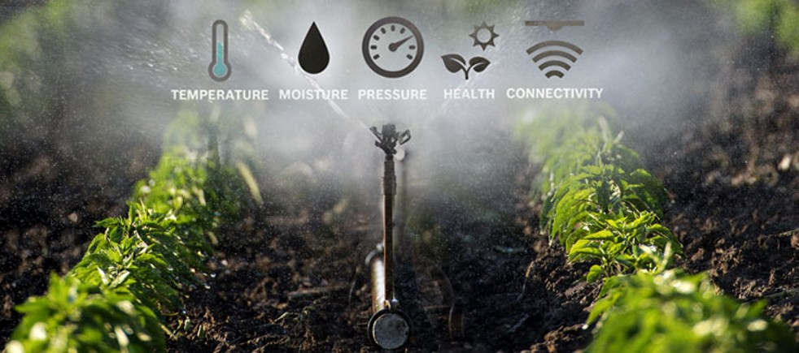
IoT – Level 2 Example …Smart Irrigation

Slide 95
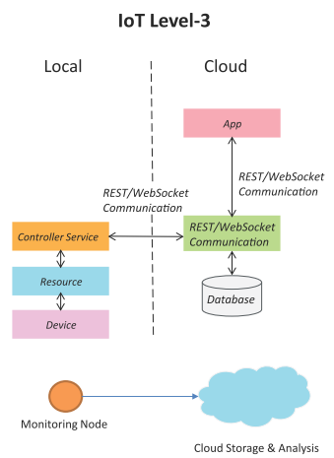
IoT Level-3
A level-3 IoT system has a single node. Data is stored and analyzed in the cloud and the application is cloud-based.
Level-3 IoT systems are suitable for solutions where the data involved is big and the analysis requirements are computationally intensive.
Book website: http://www.internet-of-things-book.com
Bahga & Madisetti, © 2015

Slide 96


IoT – Level 3 Example …Tracking Package Handling
Sensors used accelrometer and gyroscope

Slide 97

IoT Level-4
A level-4 IoT system has multiple nodes that perform local analysis. Data is stored in the cloud and the application is cloud-based.
Level-4 contains local and cloud-based observer nodes which can subscribe to and receive information collected in the cloud from IoT devices.
Level-4 IoT systems are suitable for solutions where multiple nodes are required, the data involved is big and the analysis requirements are computationally intensive.
Book website: http://www.internet-of-things-book.com
Bahga & Madisetti, © 2015

Slide 98

IoT – Level 3 Example …Noise Monitoring
Sound Sensors are used

Slide 99

IoT Level-5
A level-5 IoT system has multiple end nodes and one coordinator node.
The end nodes perform sensing and/or actuation.
The coordinator node collects data from the end nodes and sends it to the cloud.
Data is stored and analyzed in the cloud and the application is cloud-based.
Level-5 IoT systems are suitable for solutions based on wireless sensor networks, in which the data involved is big and the analysis requirements are computationally intensive.
Book website: http://www.internet-of-things-book.com
Bahga & Madisetti, © 2015

Slide 100

IoT Level-6
A level-6 IoT system has multiple independent end nodes that perform sensing and/or actuation and send data to the cloud.
Data is stored in the cloud and the application is cloud-based.
The analytics component analyzes the data and stores the results in the cloud database.
The results are visualized with the cloud-based application.
The centralized controller is aware of the status of all the end nodes and sends control commands to the nodes.
Book website: http://www.internet-of-things-book.com
Bahga & Madisetti, © 2015

Slide 101
Challenges of IoT
Connectivity
Power Management
Security
Rapid Evolution

Slide 102
Thank you !

